Slide 1
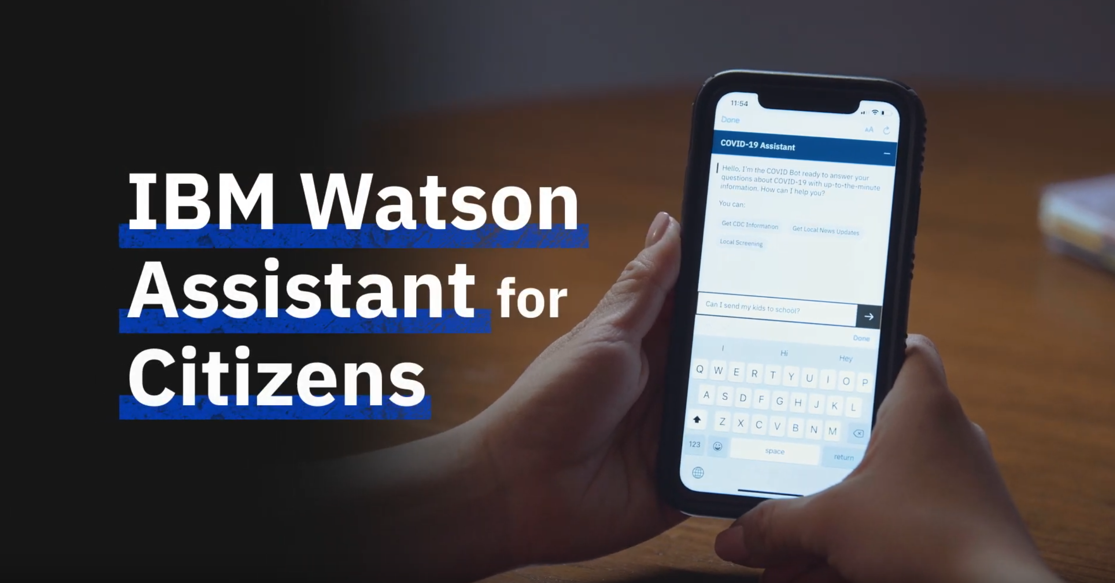
Monte Carlo Cross Validation

Slide 2

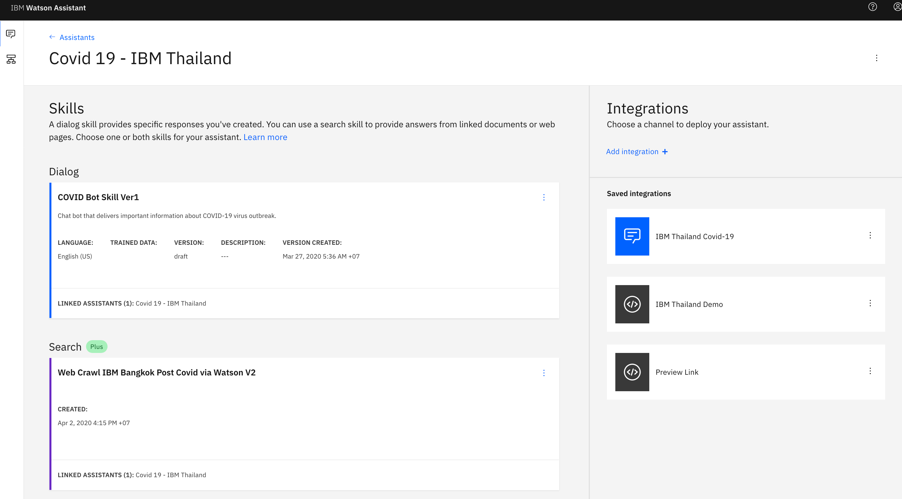

Learn: how to use Watson Assistant and Watson Discovery for COVID-19.

Slide 3

IBM Watson Assistant for Citizens in action.
DEMO: Watson Assistant for Covid-19
IBM Watson Assistant is a conversational AI platform that provides an engaging experience for users to get even their most complex issues solved. Watson Assistant for Citizens is a virtual assistant that supports both chat and speech interfaces and is pre-loaded to understand and respond to common questions about COVID-19, based on the latest CDC information.
Notes:
Watson Assistant for Customer Self Service demo: https://ibm.seismic.com/Link/Content/DC8LEZUooXqkaq0fAdIgdu7g
Watson Assistant Voice Interaction demo: https://ibm.box.com/s/xdiibfq3043v59l9554fjrkpzydwpfym

Slide 4
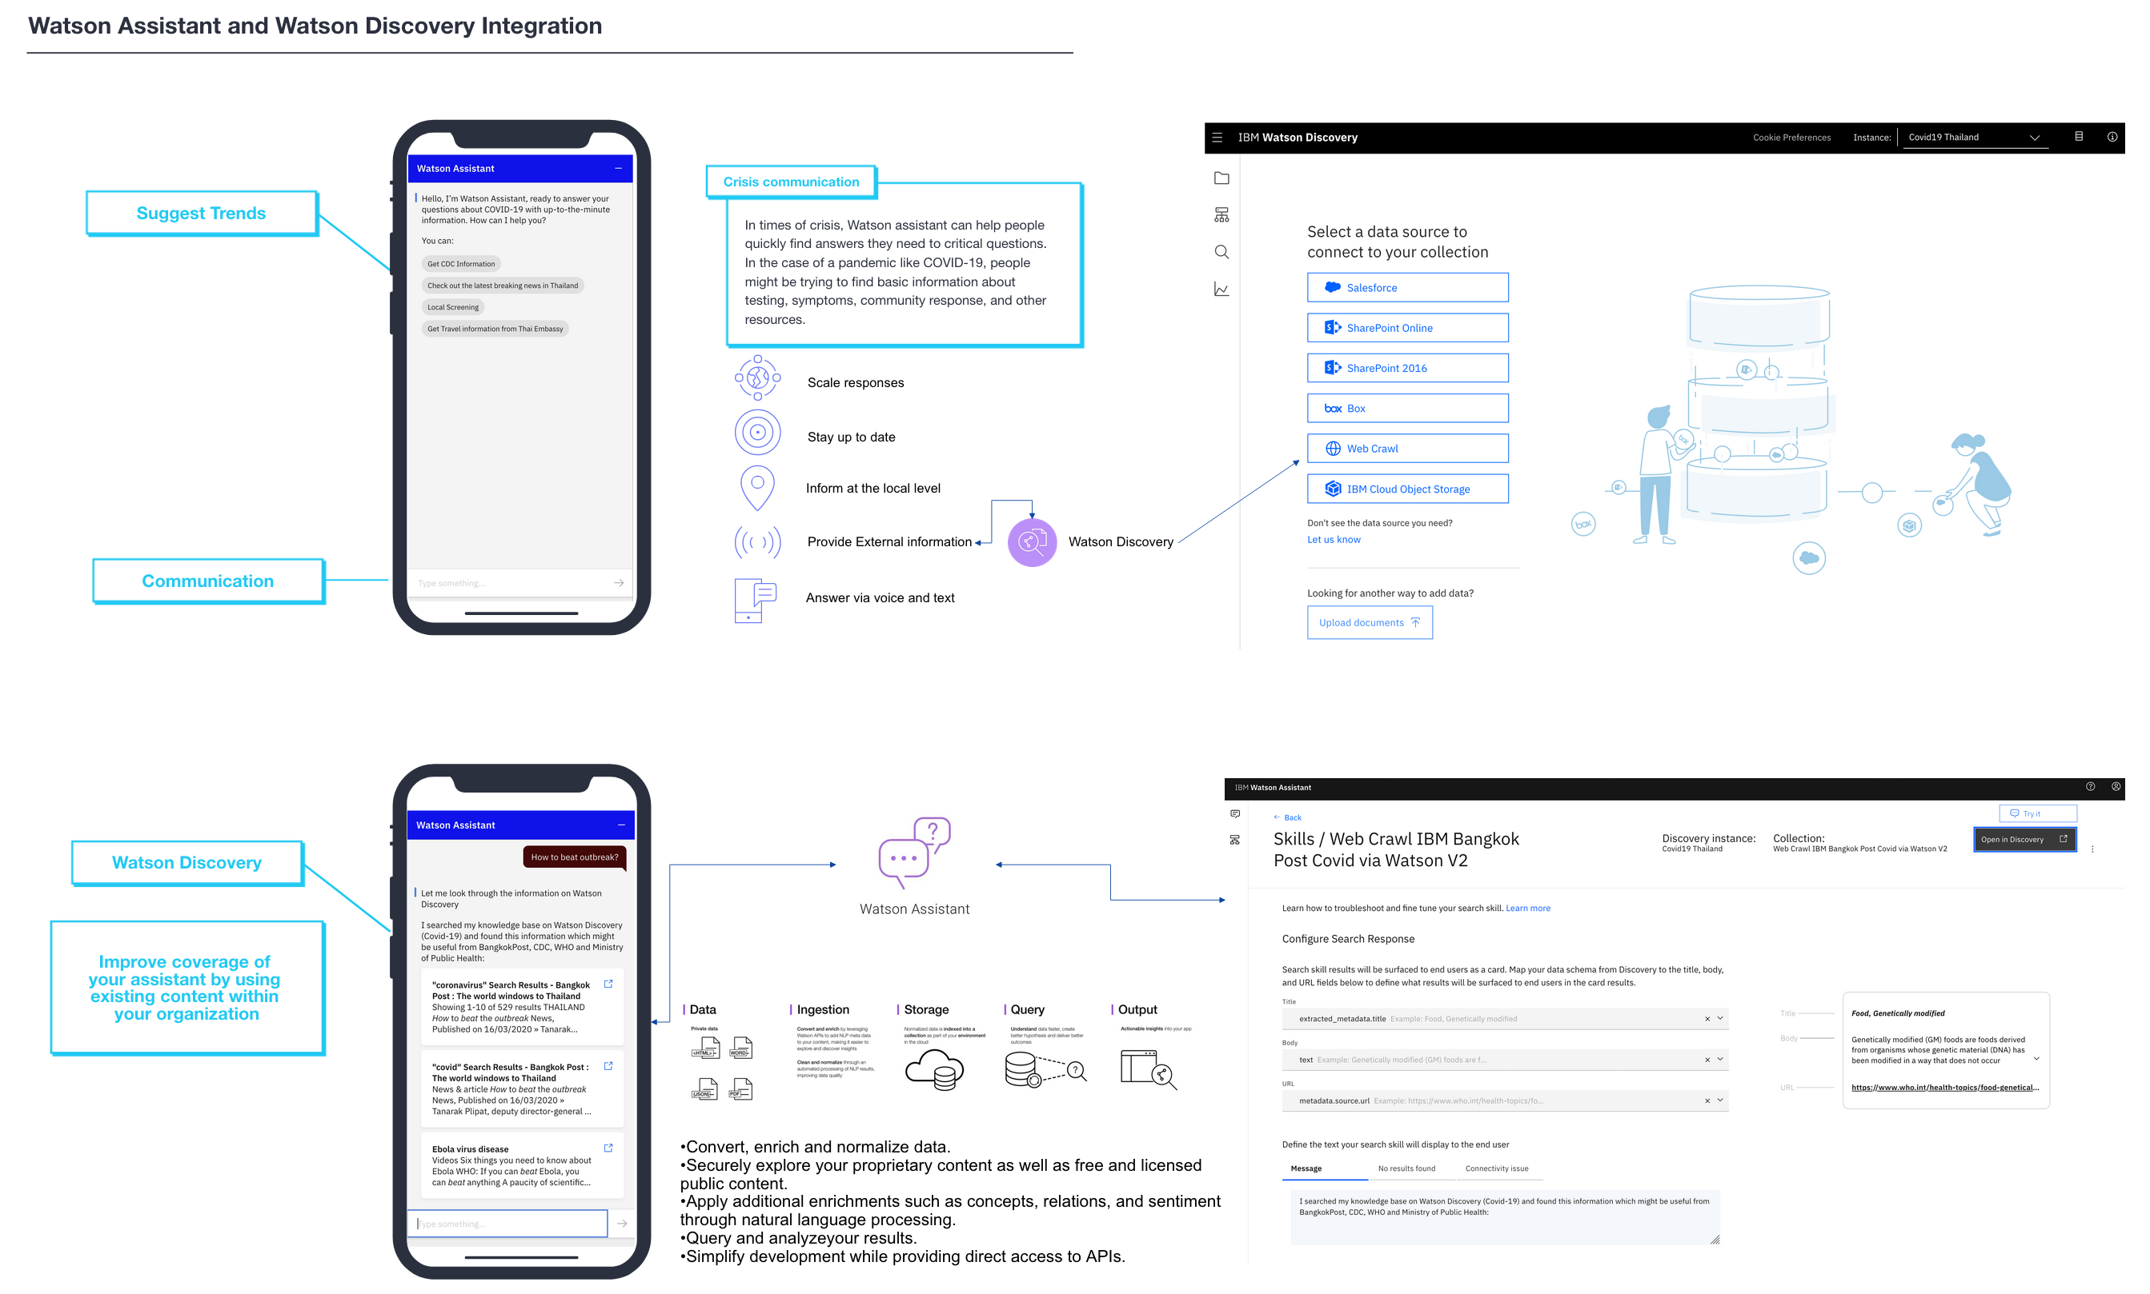

Slide 5
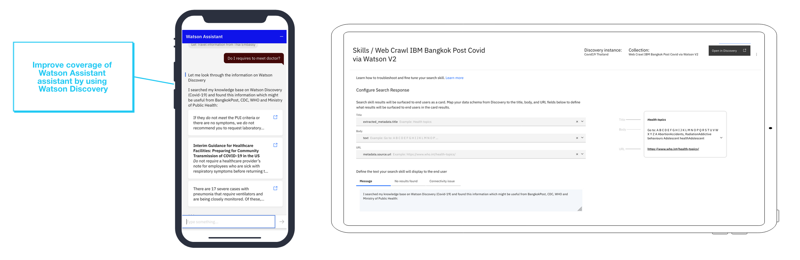
An enterprise AI search capabilities with Watson Discovery to be addressed out of the box.

Slide 6
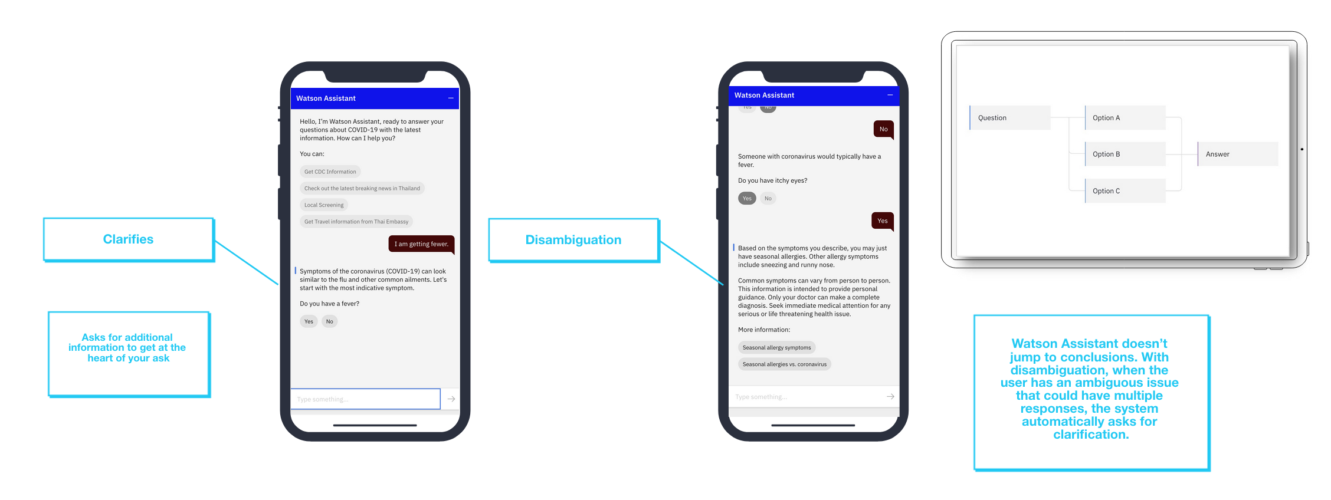
Conduct disorder: symptoms of coronavirus (COVID-19).

Slide 7
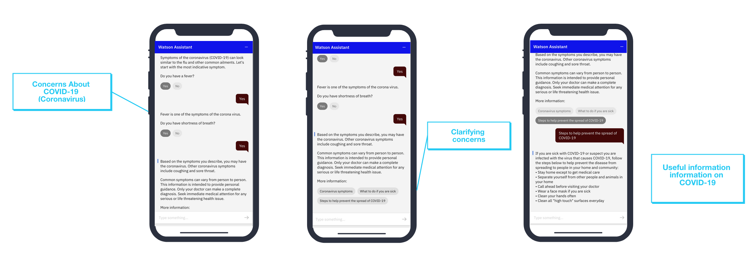
Watson Assistsant can be addressed Covid-19 symptomate by conduct interviews via fast and friendly chat.

Slide 8
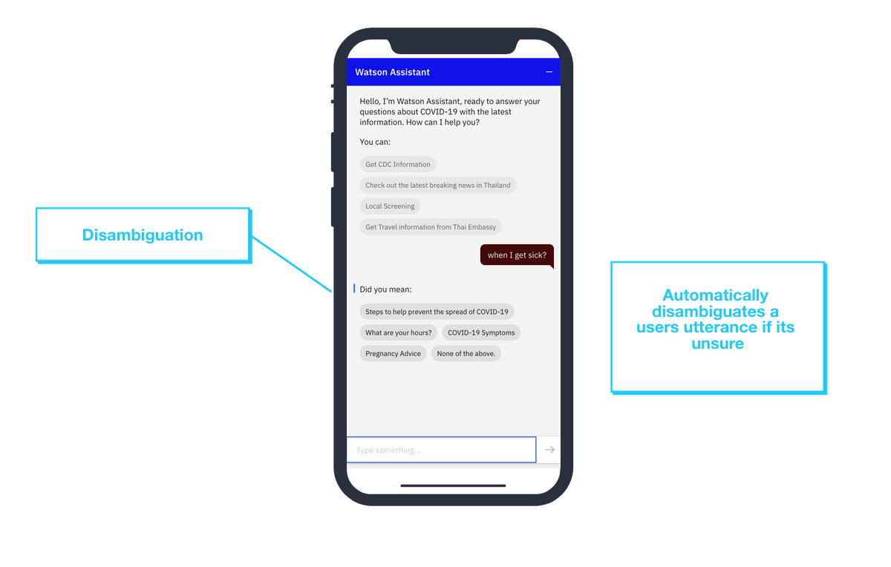
When user seek for clarification, Watson Assistant are asking user by given a clarification in a different way and provide more information so that user understand situation better.

Slide 9
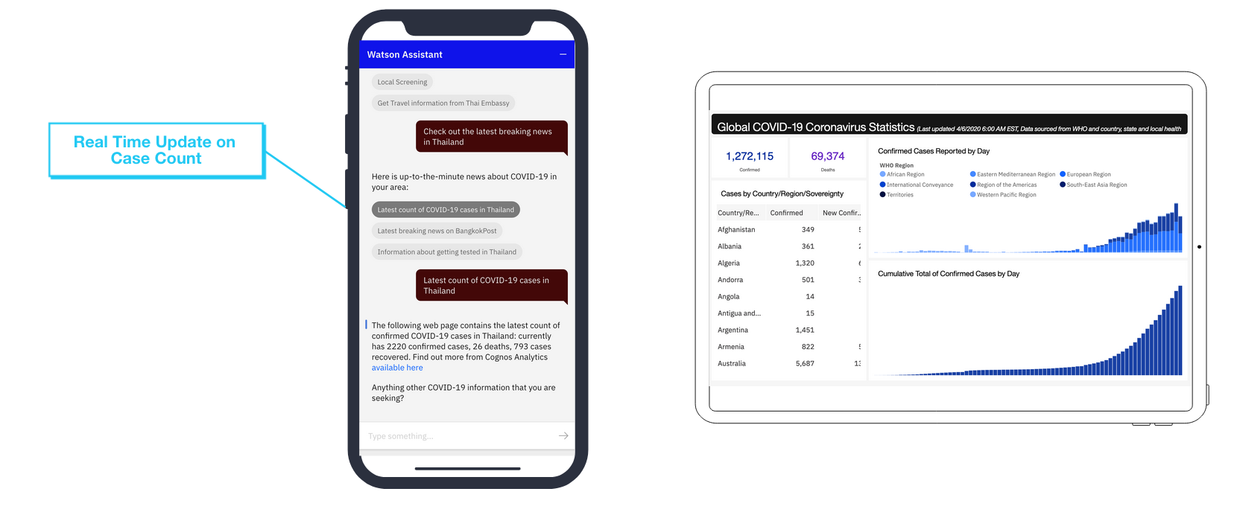
Realtime capabilities to updated covid-19 in the current situation.

Slide 10
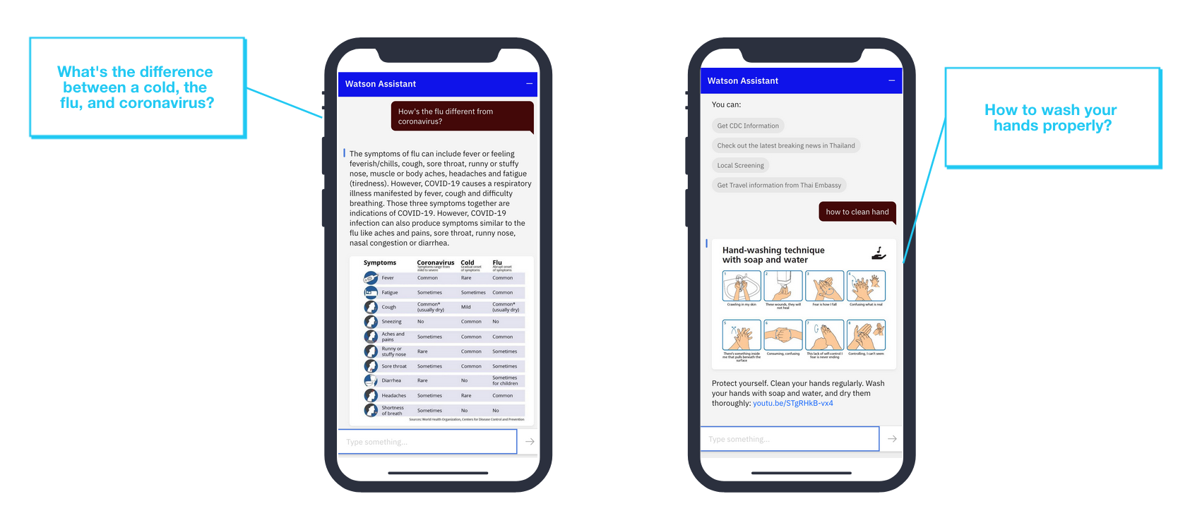
Instead of asking more clarifying questions, WA can be addressed a general model for ranking entities.

Slide 11




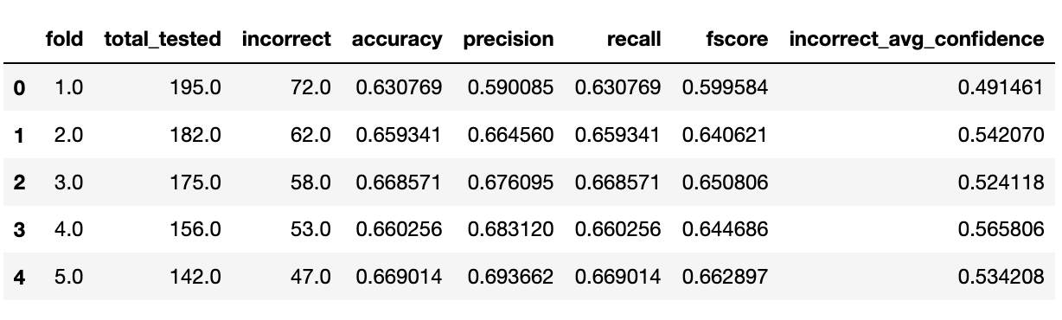
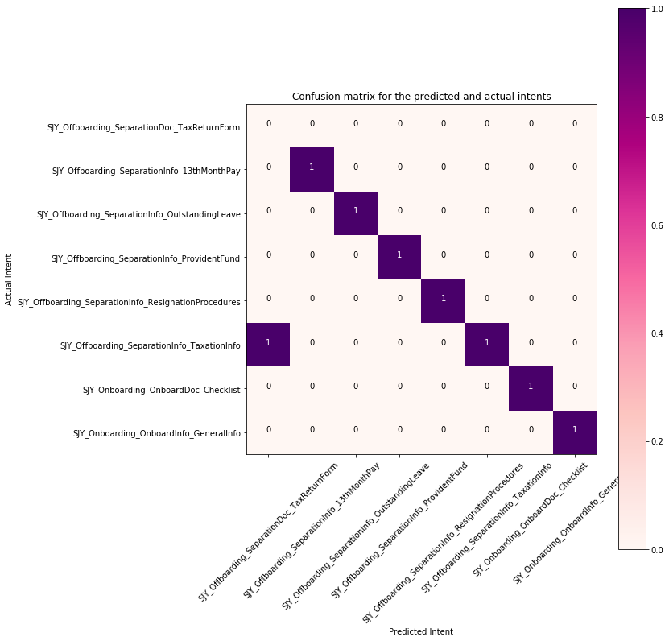


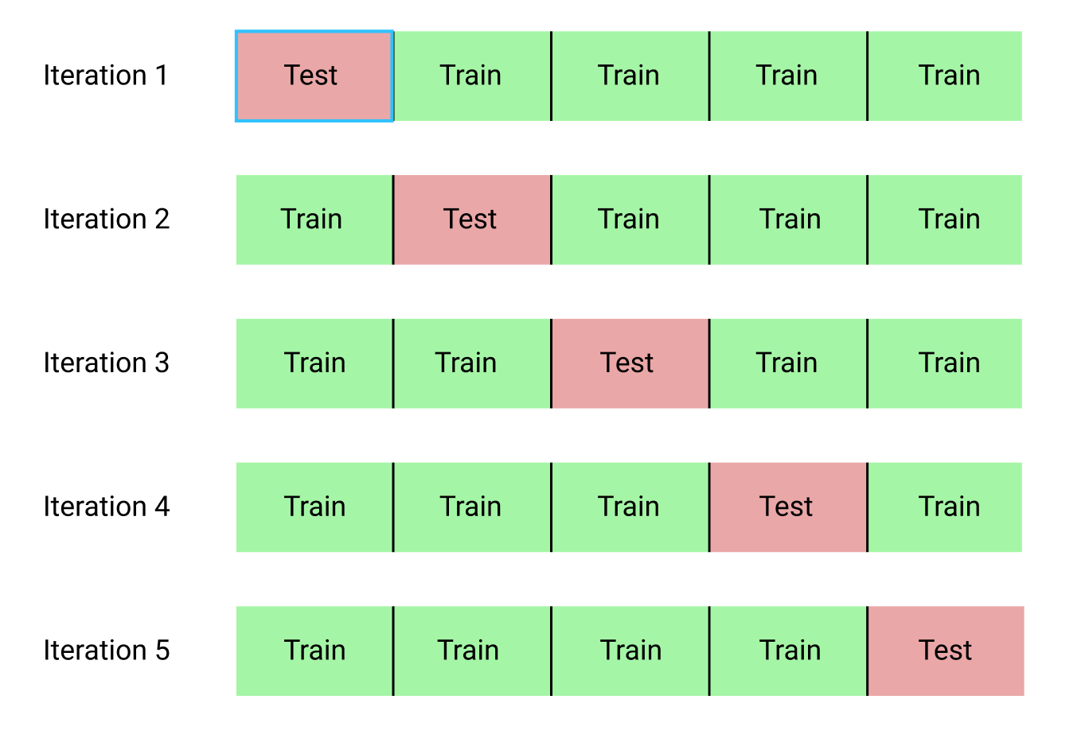

Data Mining
As world of artificial intelligence is the key to gain a competitive edge, adapt and response to an unpredictable in term of cognitive chat-bot. This concept can be produced from structured and unstructured data collected from user example.
Natural Language Understanding
How to evaluate the performance by using analytical models?
Data mining is the process of extracting patens from Watson Assistant workspace
Data mining discovers relationships of confusion data, by using data visualization techniques
Pattern Evaluation
Predictive (Supervised Techniques: Classification)
Data Analytics
Prediction
Data Visualization
Analytics
Data Training & Validation
Dialog
Intents Entities
Database Workspace

Slide 12
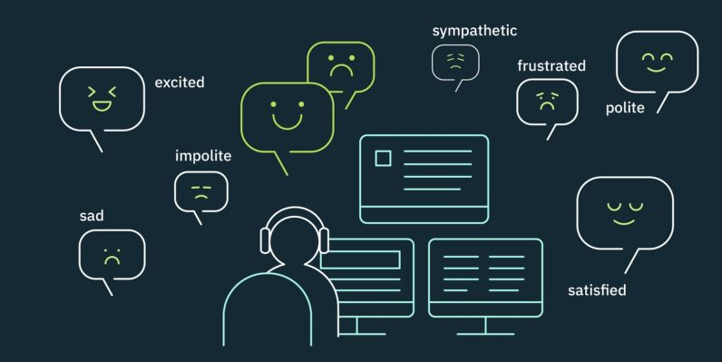

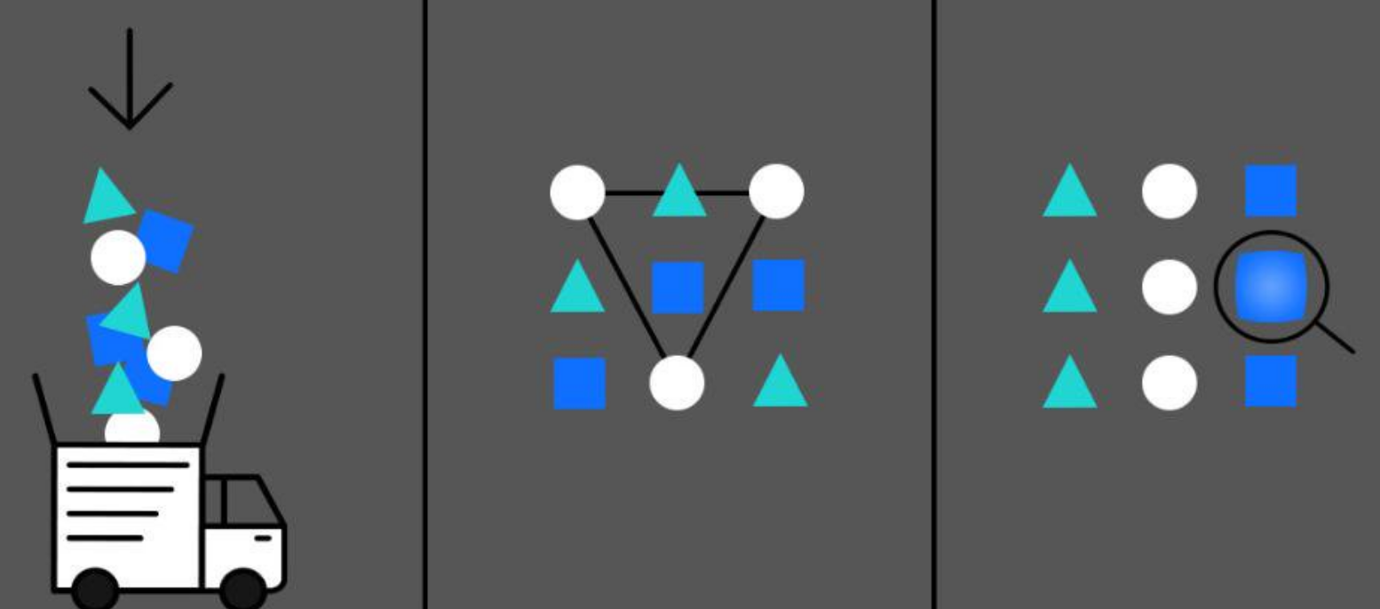

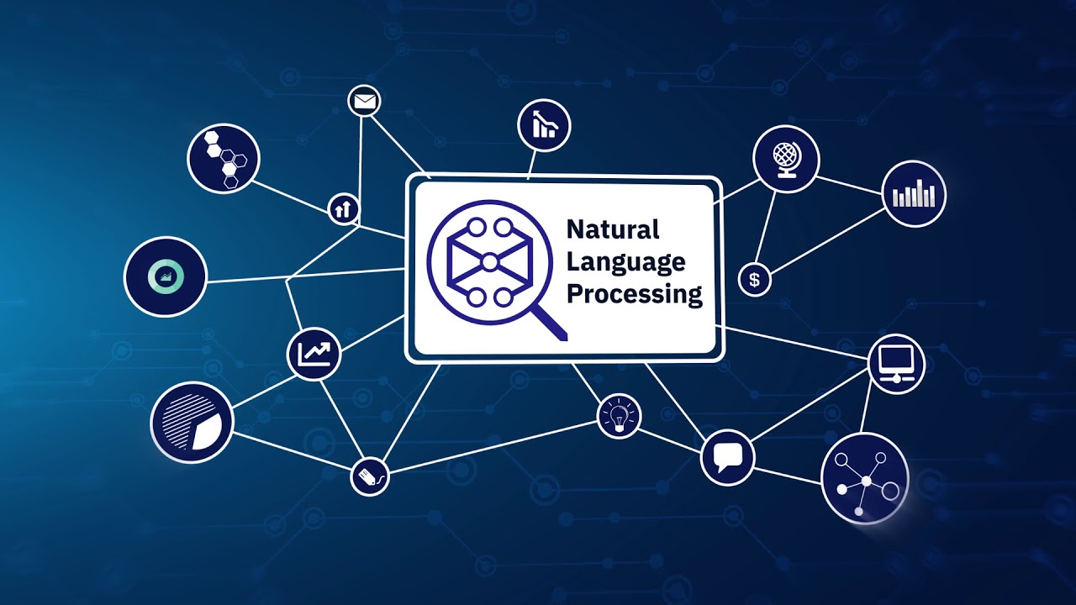
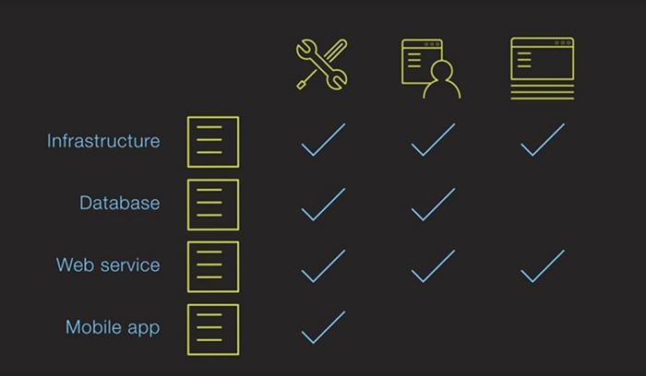
Cross-industry standard process for data mining
Business Understanding, focuses on objectives and requirement changes, then converting the concept into a data mining process to define a preliminary plan design to achieve the objectives.
Business
Understanding
Data understanding phase starts with an initial data collection from Watson Assistant and proceeds with training activities in order to get familiar with the requirement, identify data quality and discover first insights.
Data
Understanding
Data preparation phase covers chat bot activities to construct the final decision. Tasks include data analytic, record and attribute selection as well as transformation and simulating of data for data mining methods.
Deployment
Evaluation
Data
Preparation
Modeling techniques, selected and applied data science, statistic models, data mining, classification: K measuring, F score and Confusion matrix.
Modeling
Evaluation models, a key objective to determine if there is some important business matter that has not been sufficiently considered. At the end of this phase, a decision on the use of the data mining results provide more efficient models.
Deployment phase, as generating a report from python jupyter notebook as implementing a repeatable data mining process across Watson Assistant workspace.

Slide 13
Classification: Accuracy
Accuracy = (Number of correct predictions) / (Total number of prediction)
Predicted 1
Predicted 0
correct
True 1
A
B
threshold
True 0
C
D
incorrect
Accuracy = (A+D) / (A+B+C+D)

Slide 14
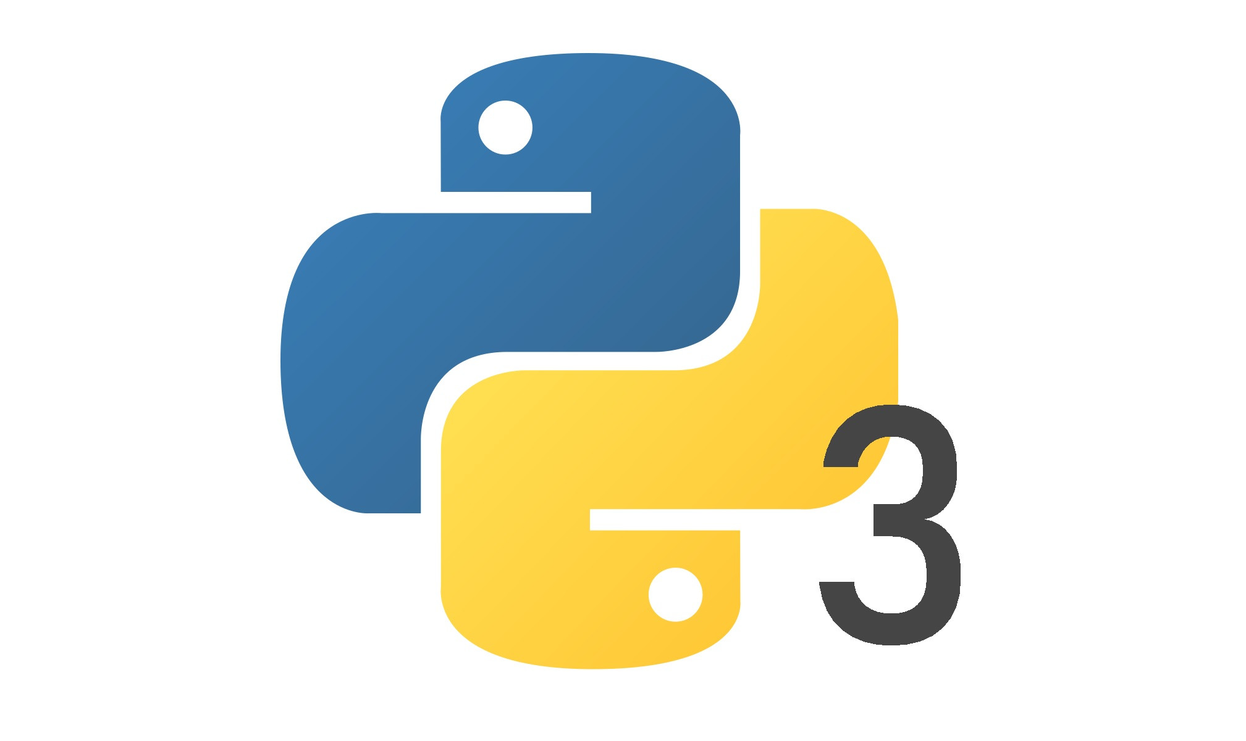
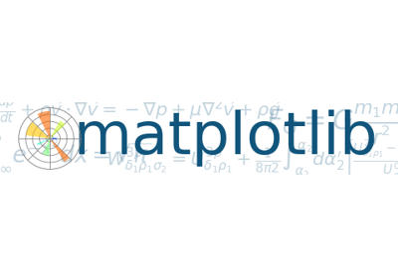
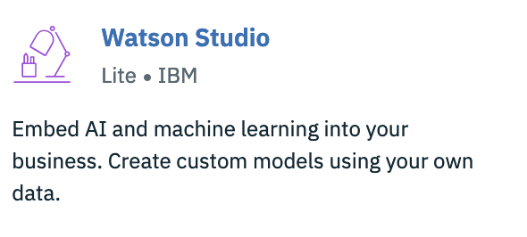
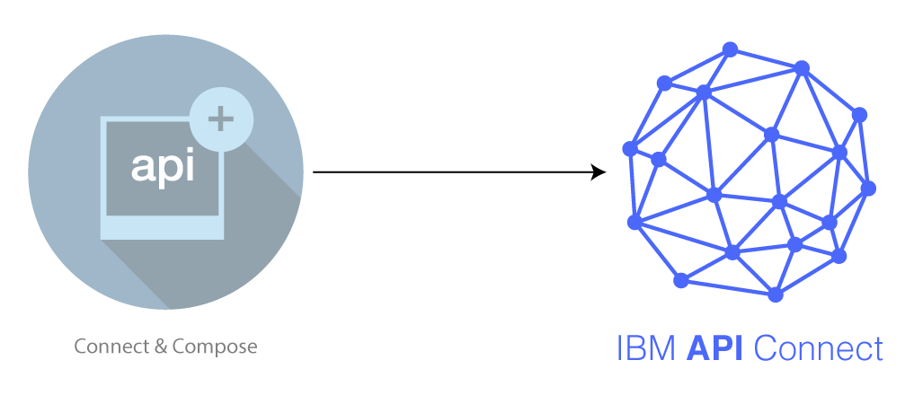
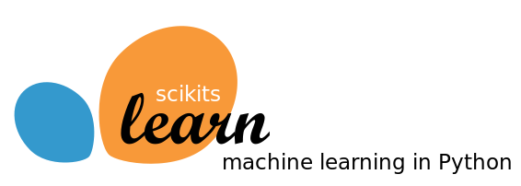
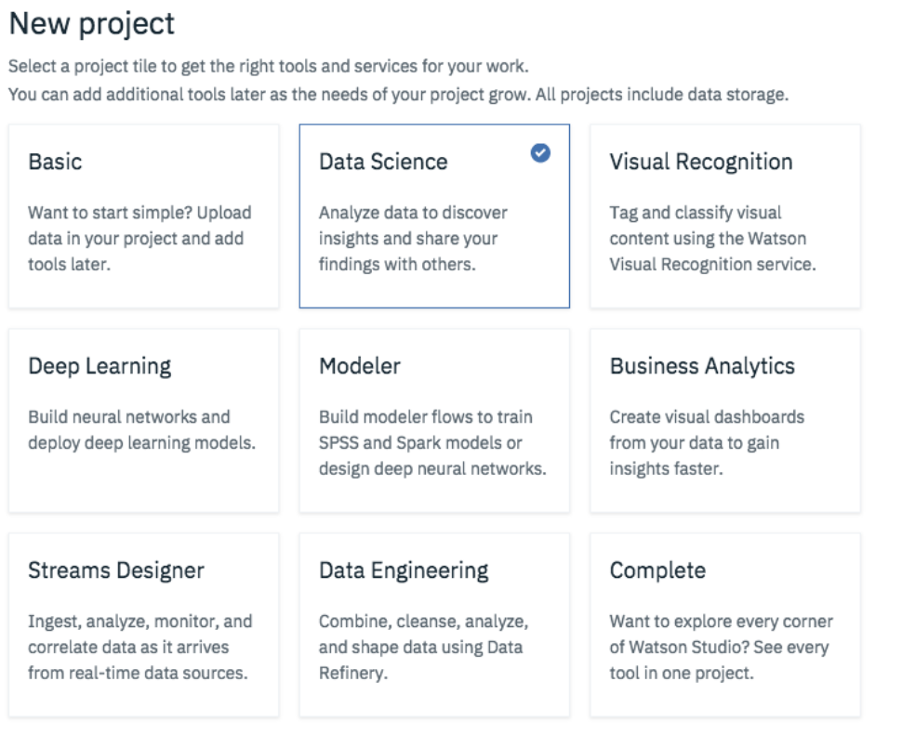



Prerequisite
Python 3
Open source web application
Watson Assistant v1 - IBM Cloud API
Jupyter Notebook + Anaconda

Slide 15
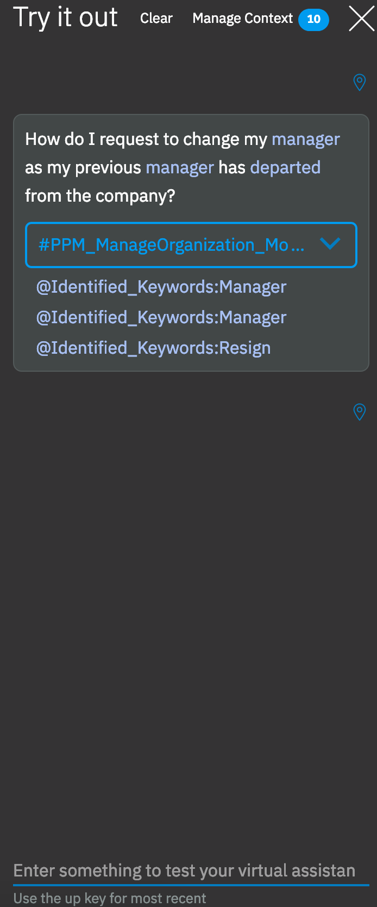
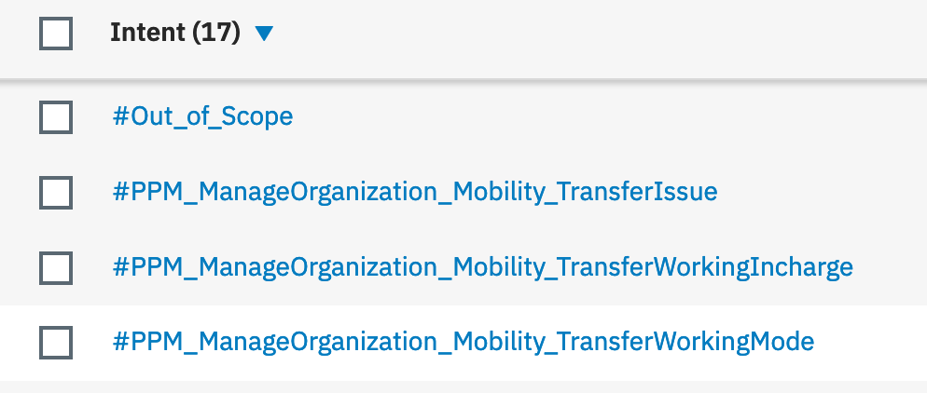
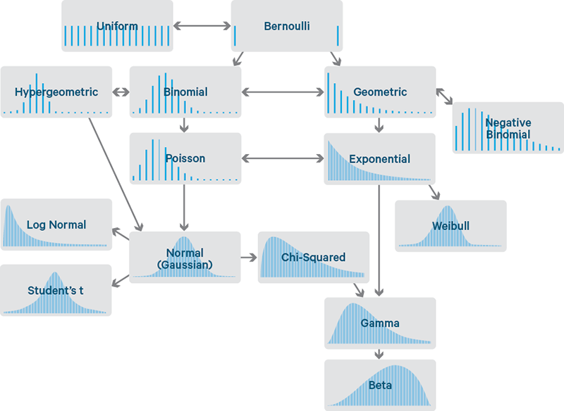
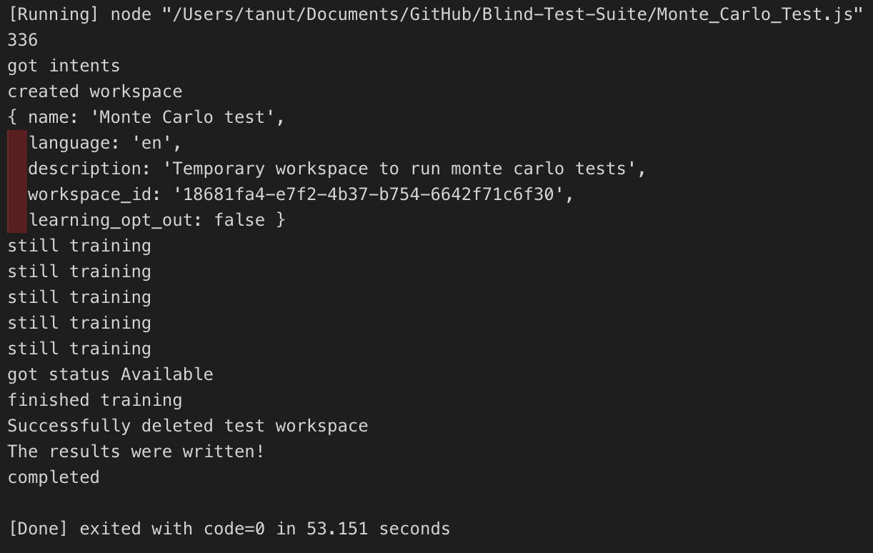
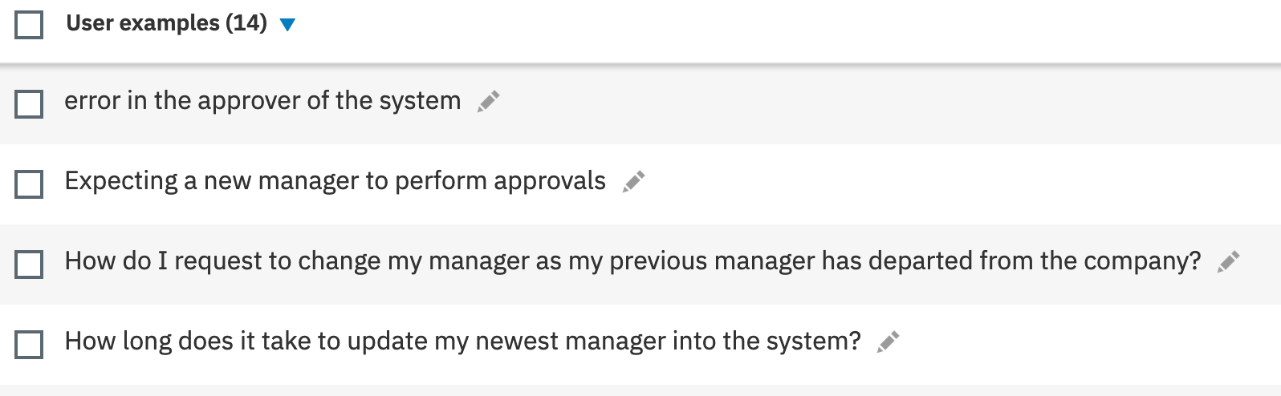
Classification: Monte Carlo
Monte Carlo, provides an accurate the intent of how all of the user example variations interact and allows each of the input factors to vary, offering a more complete understanding the range outcomes of the estimate.
Determine: Intent / User examples & Out Come
Consider the Variation
Training
Review the Result

